Slide 1
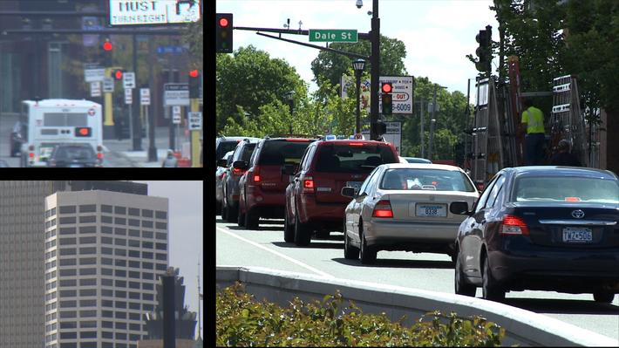
Engaging High School Students in Modeling and Simulation through Educational Media
David R. Musicant
Carleton College
S. Selcen Guzey
Purdue University

Slide 2
Key Goals
CS 10K Initiative
  10,000 new CS high school teachers in the US by 2017
How to scale up to all those schools...

Slide 3
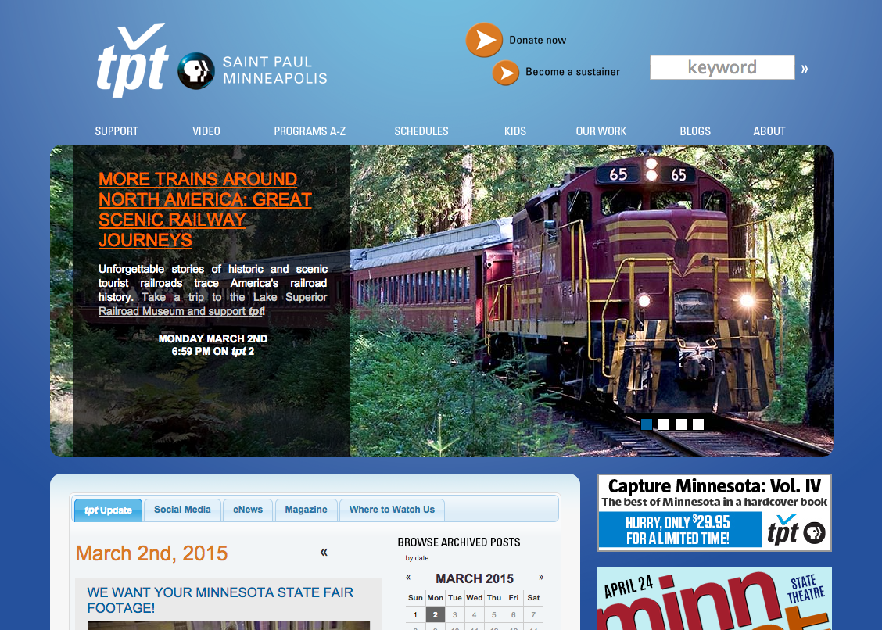

Slide 4
TPT-produced science programming
Newton’s Apple: 1983-1999
DragonflyTV: 2002-2009
SciGirls: 2010-present
Concept: bring expertise to AP CS Principles
  scale-up
  engagement

Slide 5

Perfect fit for...
AP CS Principles: Abstraction
  Use models and simulations...
    “represent phenomena”
    “formulate, refine, and test hypotheses”
Educational Media to Advance Computer Science

Slide 6
Product: TrafficJam
Contributions
  Novel approach for traffic signal optimization
  Student exercise in model development
  Student exercise in simulation exploration
  Video segments to accompany activities
  Detailed teacher’s guide

Slide 7

Introduction

Slide 8
Sample traffic signal cycle
Green in North/South direction
Yellow in North/South direction
All red
Green in East/West direction
Yellow in East/West direction
All red
Total cycle time

Slide 9
Variables for our model
Green in North/South direction
Yellow in North/South direction
All red
Green in East/West direction
Yellow in East/West direction
All red
Total cycle time

Slide 10
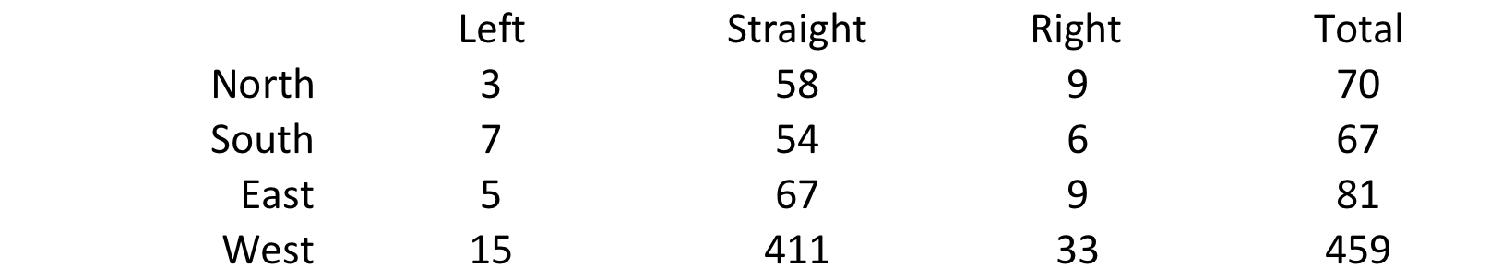
Data input to our model
Car counts per hour
Students can collect themselves, if desired

Slide 11
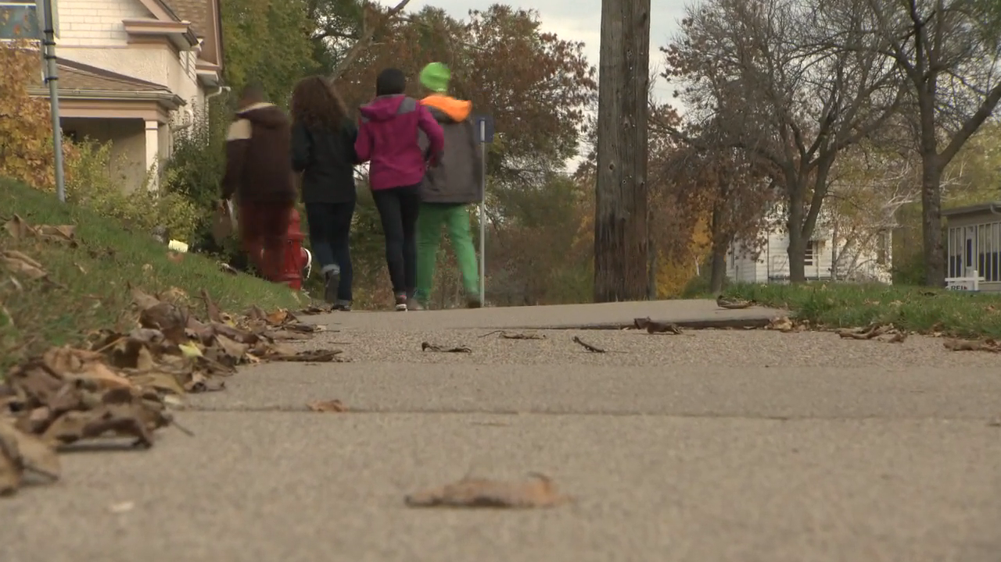
Collecting data

Slide 12
The model
If you know:
  expected number of cars per hour coming from each direction
  fraction of time each hour light is green
Can calculate...
  expected time each car waits at a red light
Optimization with constraints
  Minimize delay time
  Make sure pedestrians have enough time to cross

Slide 13

Optimizing the model

Slide 14
Optimizing a neighborhood
Analytical approach intractable with many intersections
  Adjusting one signal affects traffic patterns that arrive at another
In practice:
  Optimize each signal in isolation to get initial settings
  Tweak and adjust via neighborhood simulation

Slide 15
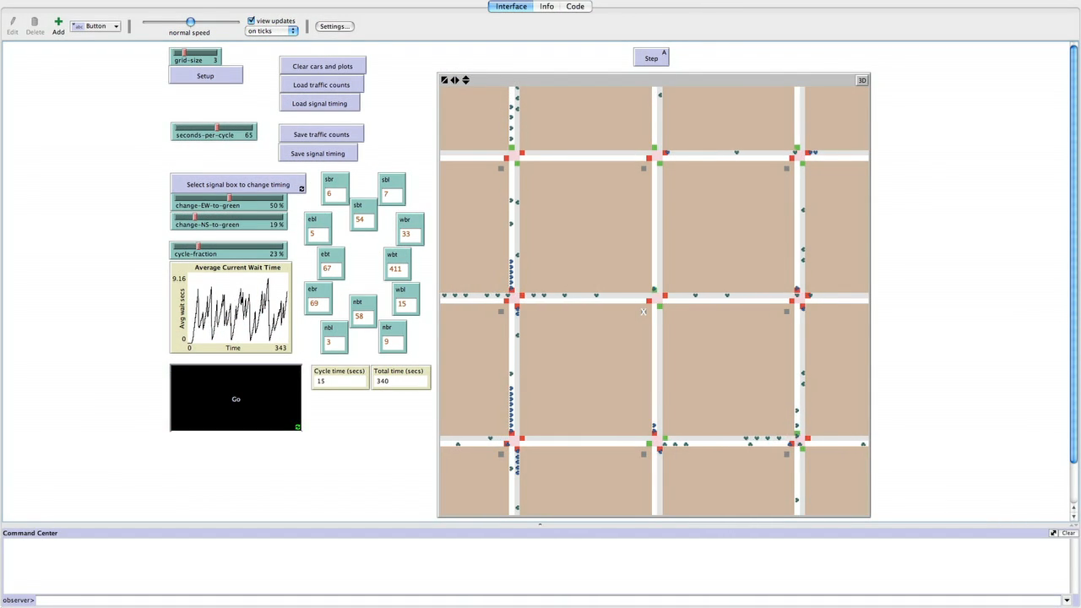
NetLogo Simulation

Slide 16
Simulation in NetLogo
Data collected now used for:
  frequency of cars appearing at edges
  probabilities of turning at intersections
Builds on supplied traffic simulation, adds:
  Bi-directional traffic
  Turning traffic
  Independent timing and phasing for each signal

Slide 17
Pilot study design: Two Groups
“Whole-project”
  Entire TrafficJam experience: videos, model, and simulation
  39 students
“Video-only”
  Watched videos only
  37 students
All students were in some sort of computing-related class

Slide 18
Pilot study results: Engagement
Most liked video for real-world scenario
  75% whole-project, 85% video-only
Some sections more popular than others
  ...and all sections rated as “like” or “like a lot” by at least half of students
Whole-project students enjoyed other activities
  particularly NetLogo simulation and working in groups

Slide 19
Pilot study: Attitudes towards CS
Attitudes toward CS didn’t shift substantially following TrafficJam
  but attitudes were already high

Slide 20
Pilot study: Content understanding
Self-reflection questions
  83% of whole-project believe they learned from video and activities
  72% of video-only students believe they learned from the video
Multiple-choice questions about project
  Whole-project students performed noticeably better on questions regarding spreadsheet and model details

Slide 21
Pilot study: some negatives
Some thought video was uninteresting
  Same students thought traffic control was uninteresting
Some thought acting was “cheesy”
  Age demographic
  Broadcast vs. school

Slide 22
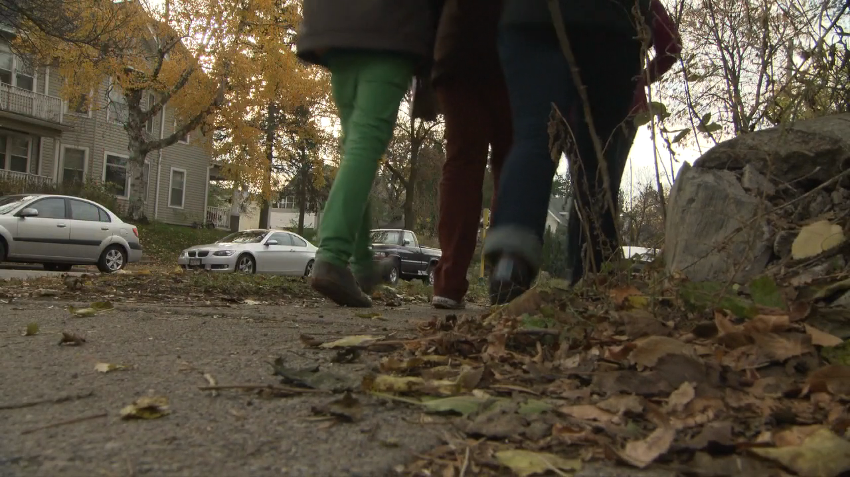
How does it end?

Slide 23
Acknowledgments: TPT Team
Co-PIs
  Richard Hudson and Kathleen O’Donnell
Production and logistics
  Marie Domingo and Emily Stevens
Story design and field production
  Angie Prindle
NSF CNS grant 1339104

Slide 24
Wrap up
TrafficJam is freely available
http://tiny.cc/emacs
Do you have a project that would fit this model? Contact us:
  Dave Musicant (dmusican@carleton.edu)
  Marie Domingo (mdomingo@tpt.org)

