Slide 1
The Netflix Prize
Sam Tucker, Erik Ruggles, Kei Kubo, Peter Nelson and James Sheridan
Advisor: Dave Musicant
Notes:
Sam louder, James quieter.
Reorder

Slide 2
The Problem
Notes:
Screenshot of netflix?

Slide 3

The User
Meet Dave:
He likes: 24, Highlander, Star Wars Episode V, Footloose, Dirty Dancing
He dislikes: The Room, Star Wars Episode II, Barbarella, Flesh Gordon
What new movies would he like to see?
What would he rate: Star Trek, Battlestar Galactica, Grease, Forrest Gump?

Slide 4
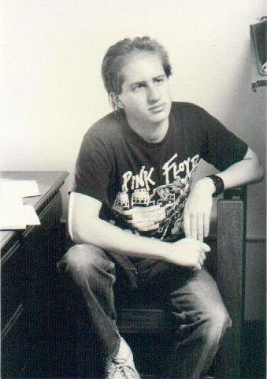
The Other User
Meet College Dave:
He likes: 24, Highlander, Star Wars Episode V, Barbarella, Flesh Gordon
He dislikes: The Room, Star Wars Episode II, Footloose, Dirty Dancing
What new movies would he like to see?
What would he rate: Star Trek, Battlestar Galactica, Grease, Forrest Gump?

Slide 5
The Netflix Prize
Netflix offered $1 million to anyone who could improve on their existing system by %10
Huge publically available set of ratings for contestants to “train” their systems on
Small “probe” set for contestants to test their own systems
Larger hidden set of ratings to officially test the submissions
Performance measured by RMSE

Slide 6
The Project
For a given user and movie, predict the rating
  RBMs
  kNN, LPP
  SVD
Identify patterns in the data
  Clustering
Make pretty pictures
  Force-directed Layout
Notes:
Define problems better.
Also, you win a million dollars.
Progress over time?

Slide 7
The Dataset
17,770 movies
480,189 users
About 100 million ratings
Efficiency paramount:
  Storing as a matrix: At least 5G (too big)
  Storing as a list: 0.5G (linear search too slow)
We started running it in Python in October…
Notes:
Half a gig? DOING EVERYTHING SLOWLY!
Sam: you should definitely say “and it’s still running”. If no one else laughs, I will.
The numbers get bigger if we say “we can’t subdivide ints”. 40G for matrix. 1.2G for list.

Slide 8
The Dataset

Slide 9
Results
 | Netflix | RBMs | kNN | SVD | Clustering
RMSE | 0.9525

Slide 10
Restricted Boltzmann Machines

Slide 11
Goals
Create a better recommender than Netflix
Investigate Problem Children of Netflix Dataset
  Napoleon Dynamite Problem
  Users with few ratings
Notes:
Dynamite problem? Polarizing.

Slide 12
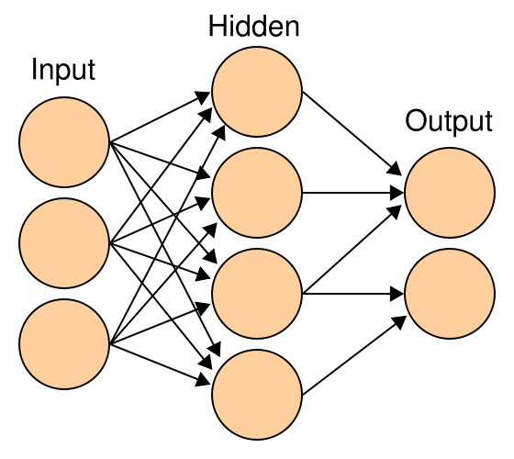
Neural Networks
Want to use Neural Networks
  Layers
  Weights
  Threshold
Notes:
Weather on a slide? Too technical maybe

Slide 13
Input
Hidden
Output
Cloudy
Is it Raining?
Freezing
Umbrella

Slide 14
Input
Hidden
Output
Cloudy
Is it Raining?
Freezing
Umbrella

Slide 15
Input
Hidden
Output
Cloudy
Is it Raining?
Freezing
Umbrella

Slide 16
Input
Hidden
Output
Cloudy
Is it Raining?
Freezing
Umbrella

Slide 17
Input
Hidden
Output
Cloudy
Is it Raining?
Freezing
Umbrella

Slide 18
Neural Networks
Want to use Neural Networks
  Layers
  Weights
  Threshold
  Hard to train large Nets
RBMs
  Fast and Easy to Train
  Use Randomness
  Biases
Notes:
Weather on a slide? Too technical maybe

Slide 19
Structure
Two sides
  Visual
  Hidden
All nodes Binary
  Calculate Probability
  Random Number
Notes:
Do it

Slide 20
24
1
2
3
4
5
Missing
Footloose
1
2
3
4
5
Missing
Highlander
1
2
3
4
5
Missing
The Room
1
2
3
4
5

Slide 21
24
1
2
3
4
5
Missing
Footloose
1
2
3
4
5
Missing
Highlander
1
2
3
4
5
Missing
The Room
1
2
3
4
5

Slide 22
24
1
2
3
4
5
Missing
Footloose
1
2
3
4
5
Missing
Highlander
1
2
3
4
5
Missing
The Room
1
2
3
4
5

Slide 23
Contrastive Divergence
Positive Side
  Insert actual user ratings
  Calculate hidden side
Notes:
Equation placement. Show car battery.

Slide 24
24
1
2
3
4
5
Missing
Footloose
1
2
3
4
5
Missing
Highlander
1
2
3
4
5
Missing
The Room
1
2
3
4
5

Slide 25
24
1
2
3
4
5
Missing
Footloose
1
2
3
4
5
Missing
Highlander
1
2
3
4
5
Missing
The Room
1
2
3
4
5

Slide 26
Contrastive Divergence
Positive Side
  Insert actual user ratings
  Calculate hidden side
Negative Side
  Calculate Visual side
  Calculate hidden side
Notes:
Equation placement. Show car battery.

Slide 27
24
1
2
3
4
5
Missing
Footloose
1
2
3
4
5
Missing
Highlander
1
2
3
4
5
Missing
The Room
1
2
3
4
5

Slide 28
24
1
2
3
4
5
Missing
Footloose
1
2
3
4
5
Missing
Highlander
1
2
3
4
5
Missing
The Room
1
2
3
4
5

Slide 29
24
1
2
3
4
5
Missing
Footloose
1
2
3
4
5
Missing
Highlander
1
2
3
4
5
Missing
The Room
1
2
3
4
5

Slide 30
24
1
2
3
4
5
Missing
Footloose
1
2
3
4
5
Missing
Highlander
1
2
3
4
5
Missing
The Room
1
2
3
4
5

Slide 31
1
2
3
4
5
Missing
1
2
3
4
5
Missing
1
2
3
4
5
Missing
1
2
3
4
5
24
1
2
3
4
5
Missing
Footloose
1
2
3
4
5
Missing
Highlander
1
2
3
4
5
Missing
The Room
1
2
3
4
5

Slide 32
Predicting Ratings
For each user:
  Insert known ratings
  Calculate Hidden side
  For each movie:
    Calculate probability of all ratings
    Take expected value

Slide 33
24
1
2
3
4
5
BSG
1
2
3
4
5
Footloose
1
2
3
4
5
Missing
Highlander
1
2
3
4
5
Missing
The Room
1
2
3
4
5

Slide 34
24
1
2
3
4
5
BSG
1
2
3
4
5
Footloose
1
2
3
4
5
Missing
Highlander
1
2
3
4
5
Missing
The Room
1
2
3
4
5

Slide 35
24
1
2
3
4
5
BSG
1
2
3
4
5
Footloose
1
2
3
4
5
Missing
Highlander
1
2
3
4
5
Missing
The Room
1
2
3
4
5

Slide 36
24
1
2
3
4
5
BSG
1
2
3
4
5
Footloose
1
2
3
4
5
Missing
Highlander
1
2
3
4
5
Missing
The Room
1
2
3
4
5

Slide 37
Results
Fri Feb 19 09:18:59 2010
The RMSE for iteration 0 is 0.904828 with a probe RMSE of 0.977709
The RMSE for iteration 1 is 0.861516 with a probe RMSE of 0.945408
The RMSE for iteration 2 is 0.847299 with a probe RMSE of 0.936846
.
.
.
The RMSE for iteration 17 is 0.802811 with a probe RMSE of 0.925694
The RMSE for iteration 18 is 0.802389 with a probe RMSE of 0.925146
The RMSE for iteration 19 is 0.801736 with a probe RMSE of 0.925184
Fri Feb 19 17:54:02 2010
2.857% better than Netflix’s advertised error of 0.9525 for the competition
Cult Movies: 1.1663 Few Ratings: 1.0510

Slide 38
Results
 | Netflix | RBMs | kNN | SVD | Clustering
RMSE | 0.9525 | 0.9252

Slide 39
k Nearest Neighbors

Slide 40
kNN
One of the most common algorithms for finding similar users in a dataset.
Simple but various ways to implement
  Calculation
    Euclidean Distance
    Cosine Similarity
  Analysis
    Average
    Weighted Average
    Majority
Notes:
Examples. People standing at the front of the room?

Slide 41
The Methods of Measuring Distances
Euclidean Distance
D(a , b)
Cosine Similarity
θ
Notes:
Draw some circles and angles.
And distance in the plane.

Slide 42
The Problem of Cosine Similarity
Problem:
  Because the matrix of users and movies are highly sparse, we often cannot find users who rate the same movies.
Conclusion:
  Cannot compare users in these cases because similarity becomes 0, when there’s no common rated movie.
Solution:
  Set small default values to avoid it.

Slide 43
RMSE( Root Mean Squared Error)
k | Euclidean | Cosine Similarity* | Cosine Similarity w/ Default Values
1 | 1.593319 | 1.442683 | 1.430385
2 | 1.390024 | 1.277889 | 1.257577
3 | 1.293187 | 1.224314 | 1.222081
… | … | … | …
27 | 1.160647 | 1.147757 | 1.149164
28 | 1.160366 | 1.147843 | 1.149094
29 | 1.160058 | 1.148418 | 1.149145
* In Cosine Similarity, the RMSE are the result among predicted ratings which program
returned. There are a lot of missing predictions where the program cannot find nearest neighbors.
Notes:
Define why 1.148>1.149. Missing predictions.

Slide 44
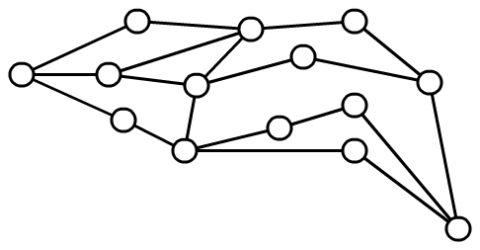
Local Minimum Issue
Notes:
Graph!?!?!?!?!?!!

Slide 45
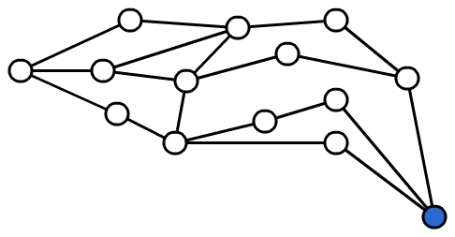
Local Minimum Issue

Slide 46
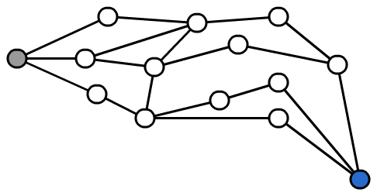

Local Minimum Issue

Slide 47
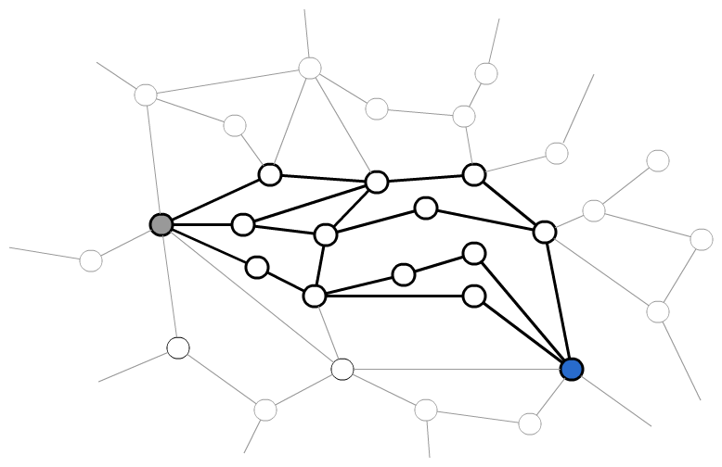
Local Minimum Issue

Slide 48
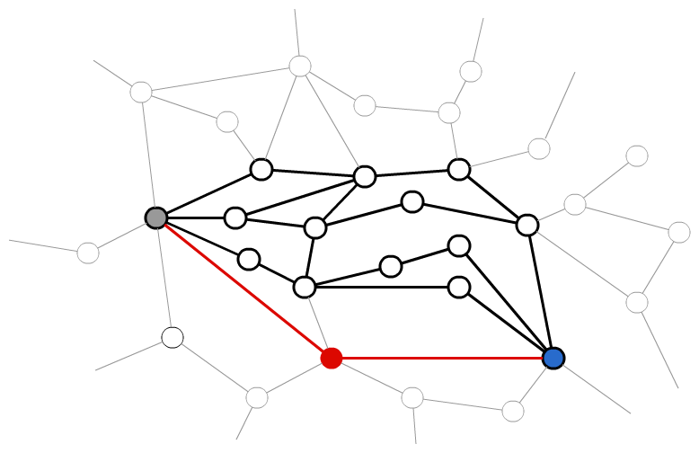
Local Minimum Issue

Slide 49
Dimensionality Reduction
LPP (Locality Preserving Projections)
  Construct the adjacency graph
  Choose the weights
  Compute the eigenvector equation below:
Notes:
Linear Algebra?

Slide 50
The Result of Dimensionality Reduction
Other techniques when k = 15:
  Euclidean: error = 1.173049
  Cosine: error = 1.147835
  Cosine w/ Defaults: error = 1.148560
Using dimensionality reduction technique:
  k = 15 and d = 100: error = 1.060185

Slide 51
Results
 | Netflix | RBMs | kNN | SVD | Clustering
RMSE | 0.9525 | 0.9252 | 1.0602

Slide 52
Singular Value Decomposition

Slide 53
The Dataset

Slide 54
A Simpler Dataset

Slide 55
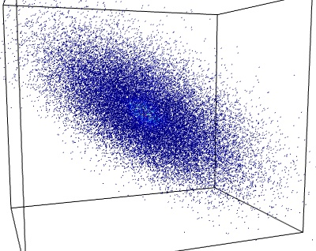
A Simpler Dataset
Collection of points
A Scatterplot
Notes:
Give motivation here? Missing data

Slide 56
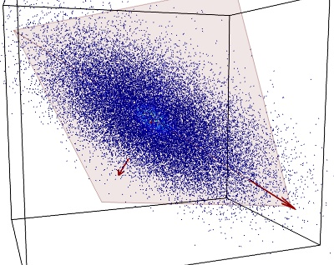
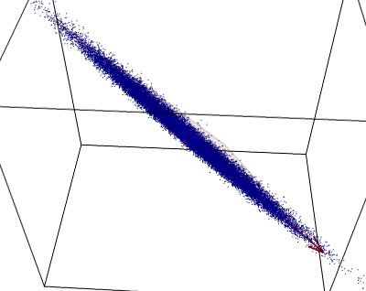
Low-Rank Approximations
The points mostly lie on a plane
Perpendicular variation = noise

Slide 57
Low-Rank Approximations
How do we discover the underlying 2d structure of the data?
Roughly speaking, we want the “2d” matrix that best explains our data.
Formally,
Notes:
How do we discover/explain structure that we see

Slide 58
Low-Rank Approximations
Singular Value Decomposition (SVD) in the world of linear algebra
Principal Component Analysis (PCA) in the world of statistics

Slide 59
Practical Applications
Compressing images
Discovering structure in data
“Denoising” data
Netflix: Filling in missing entries (i.e., ratings)

Slide 60
Netflix as Seen Through SVD

Slide 61
Netflix as Seen Through SVD
Strategy to solve the Netflix problem:
  Assume the data has a simple (affine) structure with added noise
  Find the low-rank matrix that best approximates our known values (i.e., infer that simple structure)
  Fill in the missing entries based on that matrix
  Recommend movies based on the filled-in values

Slide 62
Netflix as Seen Through SVD

Slide 63
Netflix as Seen Through SVD
Every user is represented by a k-dimensional vector (This is the matrix U)
Every movie is represented by k-dimensional vector (This is the matrix M)
Predicted ratings are dot products between user vectors and movie vectors

Slide 64
SVD Implementation
Alternating Least Squares:
  Initialize U and M randomly
  Hold U constant and solve for M (least squares)
  Hold M constant and solve for U (least squares)
  Keep switching back and forth, until your error on the training set isn’t changing much (alternating)
  See how it did!

Slide 65
SVD Results
How did it do?
  Probe Set: RMSE of about .90, ??% improvement over the Netflix recommender system
Notes:
Probe set…. To THE INTRODUCTION!

Slide 66
Dimensional Fun
Each movie or user is represented by a 60-dimensional vector
Do the dimensions mean anything?
Is there an “action” dimension or a “comedy” dimension, for instance?

Slide 67
Dimensional Fun
Some of the lowest movies along the 0th dimension:
  Michael Moore Hates America
  In the Face of Evil: Reagan’s War in Word & Deed
  Veggie Tales: Bible Heroes
  Touched by an Angel: Season 2
  A History of God
Notes:
What are dimensions?

Slide 68
Dimensional Fun
Some of the highest movies along the 47th dimension:
  Emanuelle in America
  Lust for Dracula
  Timegate: Tales of the Saddle Tramps
  Legally Exposed
  Sexual Matrix

Slide 69
Dimensional Fun
Some of the highest movies along the 55th dimension:
  Strange Things Happen at Sundown
  Alien 3000
  Shaolin vs. Evil Dead
  Dark Harvest
  Legend of the Chupacabra

Slide 70
Results
 | Netflix | RBMs | kNN | SVD | Clustering
RMSE | 0.9525 | 0.9252 | 1.0602 | .90

Slide 71
Clustering

Slide 72
Goals
Identify groups of similar movies
Provide ratings based on similarity between movies
Provide ratings based on similarity between users

Slide 73










Slide 80






Slide 81
Predictions
We want to know what College Dave will think of “Grease”.
Find out what he thinks of the prototype most similar to “Grease”.

Slide 82
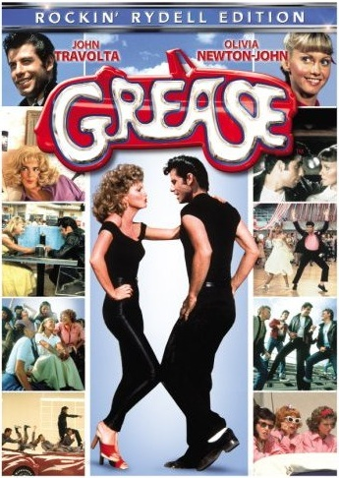
College Dave gives “Grease”
1 Star!

Slide 83
Other Approaches
Distribute across many machines
Density Based Algorithms
Ensembles
  It is better to have a bunch of predictors that can do one thing well, then one predictor that can do everything well.
  (In theory, but it actually doesn’t help much.)

Slide 84
Results
Rating prediction
Genre Clustering
Best rmse≈.93 but randomness gives us a pretty wide range.
Classifying based only on the most popular: 40%
Classifying based on two most popular: 63%
Notes:
IMDB correlation. Where are genres coming from.

Slide 85
Clustering Fun!
<“Billy Madison”, “Happy Gilmore”>(These are the ONLY two movies in the cluster)
<“Star Wars V”, “LOTR: RotK”,”LOTR: FotR”,”The Silence of the Lambs”,”Shrek”,” Caddyshack”,”Pulp Fiction”,” Full Metal Jacket”> (These are AWESOME MOVIES!)
<“Star Wars II”,”Men In Black II”, “What Women Want”> (These are NOT!)
<“Family Guy: Vol 1”, “Family Guy: Freakin’ Sweet Collection”,”Futurama: Vol 1 – 4”>(Pretty obvious)
<“2002 Olympic Figure Skating Competition”,” UFC 50: Ultimate Fighting Championship: The War of '04”> (Pretty surprising)

Slide 86
More Clustering Fun!
<“Out of Towners”,”The Ice Princess”,”Charlie’s Angels”,”Michael Moore hates America”>(Also surprising)
<“Magnum P.I.: Season 1”, “Oingo Boingo: Farewell”,” Gilligan's Island: Season 1”, “Paul Simon: Graceland”> (For those of you born before 1965)
<“Grease”,”Dirty Dancing”, “Sleepless in Seattle”,”Top Gun”, ”A Few Good Men”>(Insight into who actually likes Tom Cruise)
<“Shaolin Soccer”,”Drunken Master”,”Ong Bak: Thai Warrior”,”Zardoz”>(“Go forth, and kill! Zardoz has spoken.”)

Slide 87
The last of the fun ☹
(Also, movies to recommend to College Dave)
<“Scorpions: A Savage Crazy World”, ”Metallica: Cliff 'Em All”,”Iron Maiden: Rock in Rio”,” Classic Albums: Judas Priest: British Steel”>(If only we could recommend based on T-Shirt purchases…)
<“Blue Collar Comedy Tour: The Movie”,” Jeff Foxworthy: Totally Committed”, ”Bill Engvall: Here's Your Sign”,” Larry the Cable Guy: Git-R-Done”>(Intellectual humor.)
<“Beware! The Blob”,”They crawl”,” Aquanoids”,”The dead hate the living”> (Ahhhhhhhh!!!!!)
<“The Girl who Shagged me”, ”Sports Illustrated Swimsuit Edition”, ”Sorority Babes in the Slimeball Bowl-O-Rama”, ”Forrest Gump: Bonus Material”> (Did not see the last one coming…)
Notes:
Dave anecdote.

Slide 88
Results
 | Netflix | RBMs | kNN | SVD | Clustering
RMSE | 0.9525 | 0.9252 | 1.0602 | 0.90 | 0.93

Slide 89
Visualization
Notes:
Mo slides. Mo problems.

Slide 90
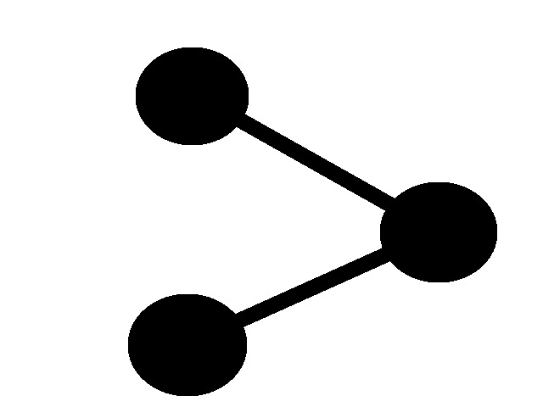

Slide 91
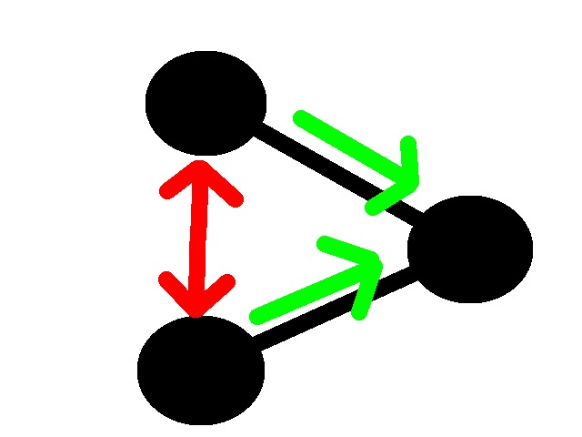

Slide 92


Slide 93
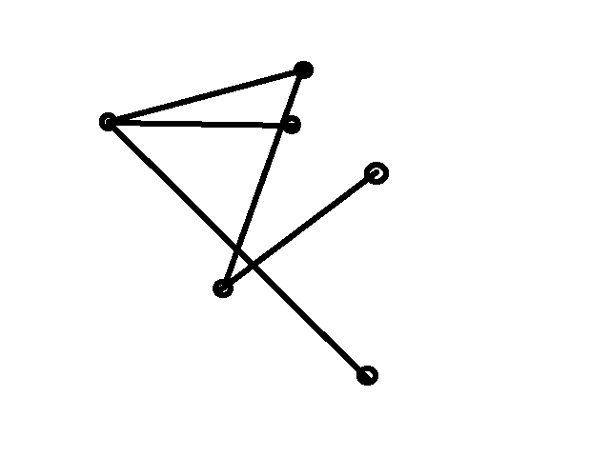

Slide 94
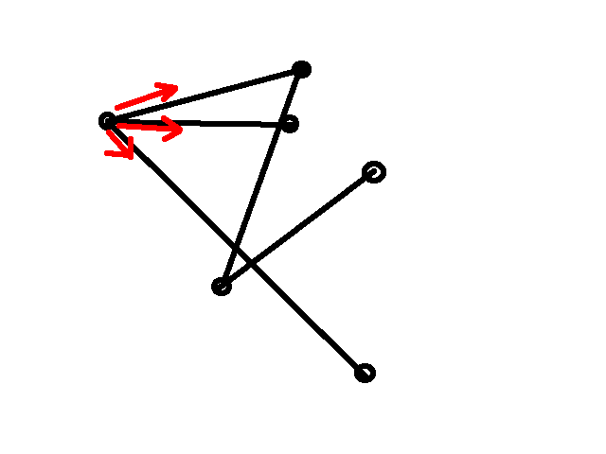

Slide 95
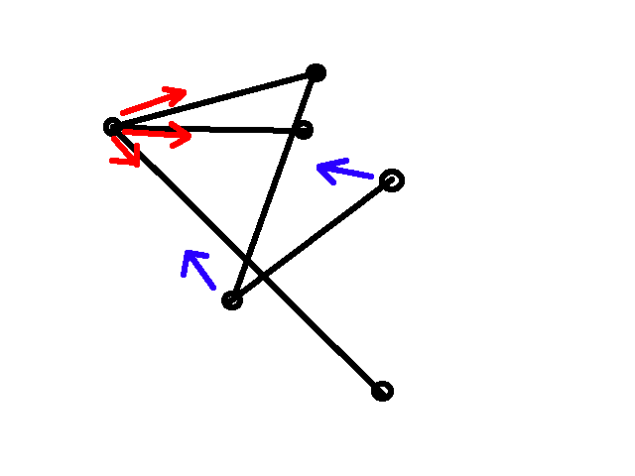

Slide 96


Slide 97
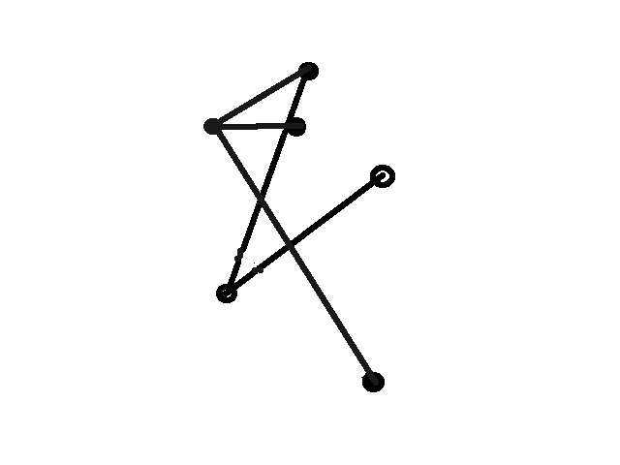

Slide 98
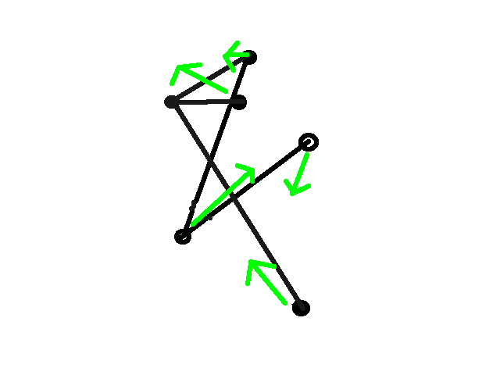

Slide 99
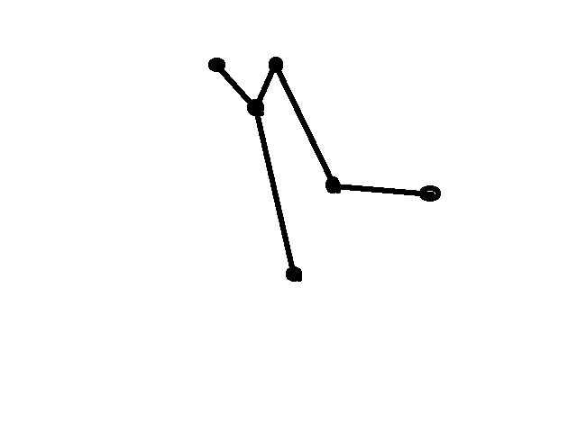

Slide 100
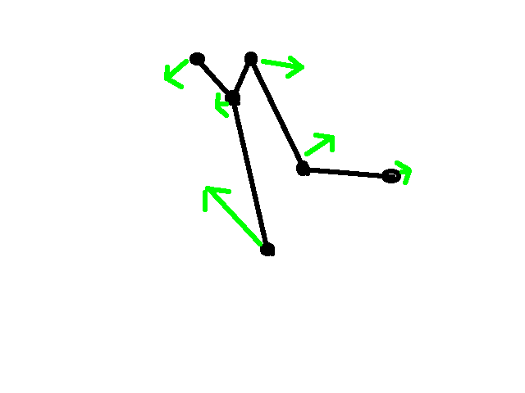

Slide 101
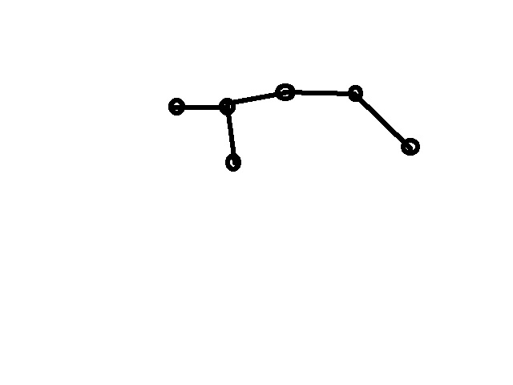

Slide 102
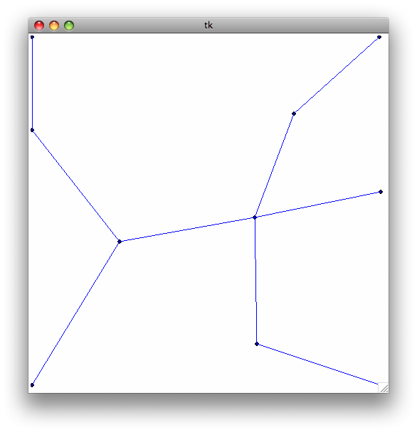
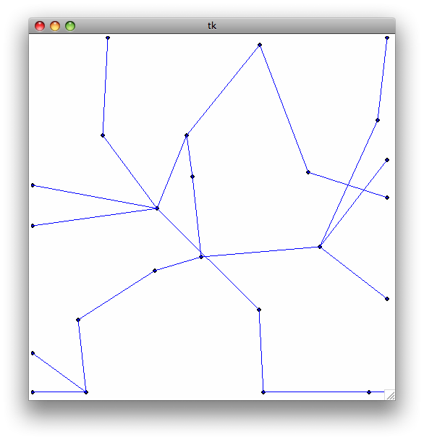
Notes:
What are points? What are lines? Pseudocode?

Slide 103
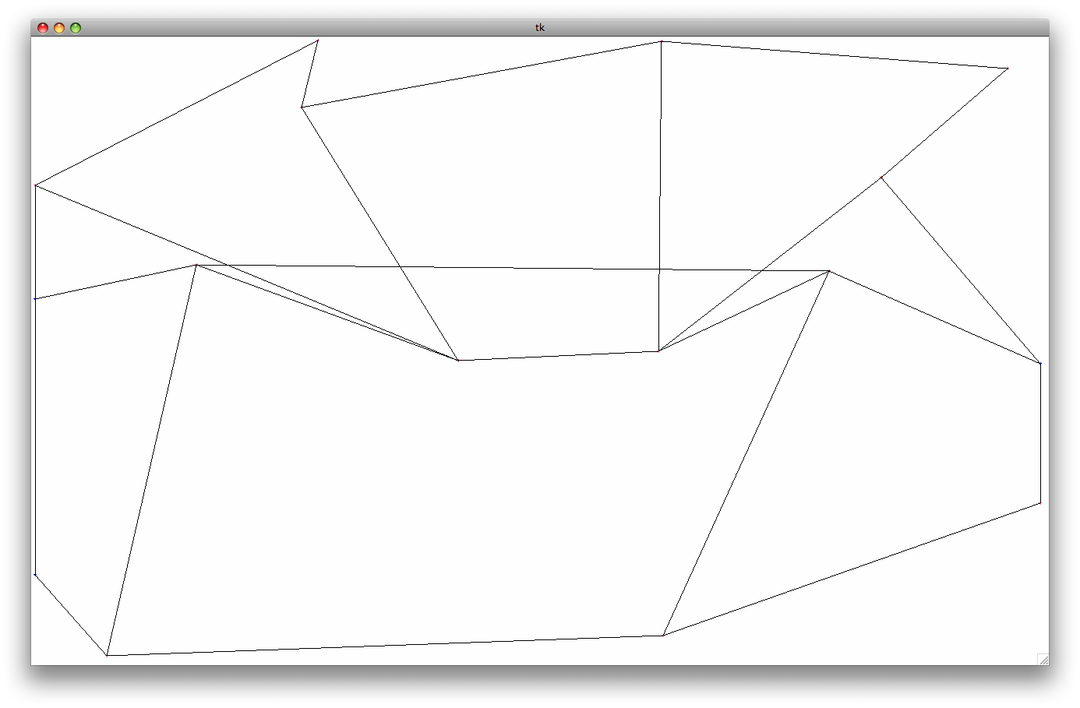
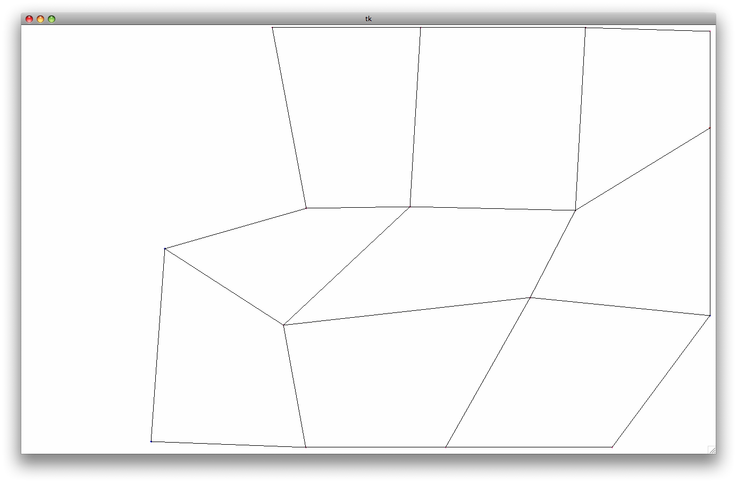
Notes:
Grid?

Slide 104

Notes:
Colors. Points are movies!

Slide 105
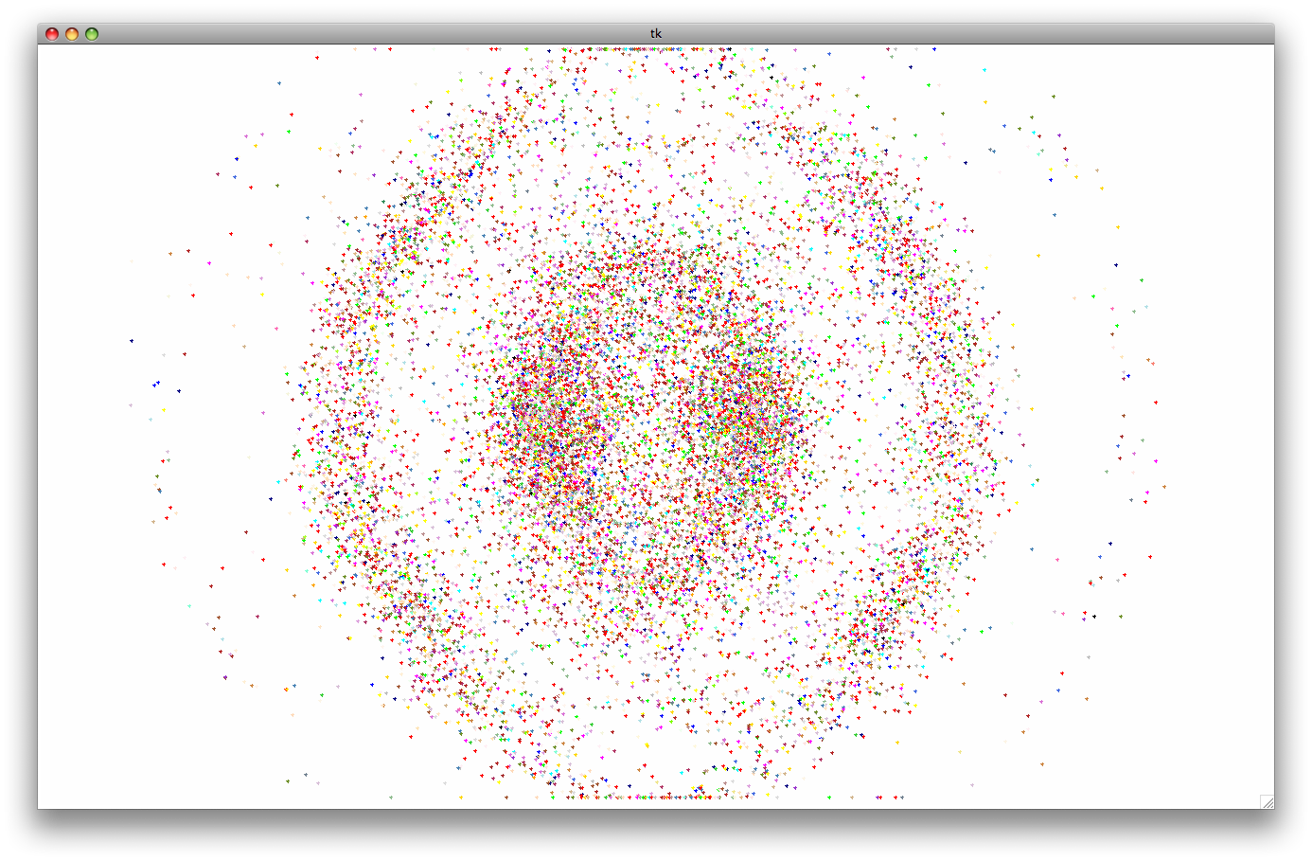

Slide 106
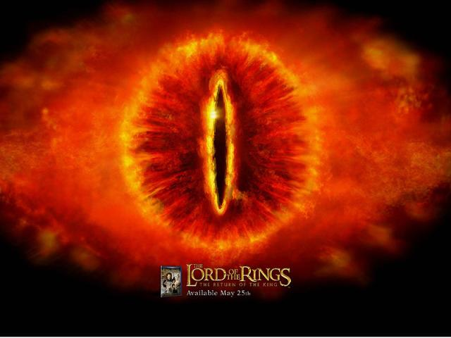

Slide 107
THANK YOU!
Questions?
  Email compsgroup@lists.carleton.edu

Slide 108
References
ifsc.ualr.edu/xwxu/publications/kdd-96.pdf
gael-varoquaux.info/scientific_computing/ica_pca/index.html

